Slide 1
Asian Criminological Society (ACS) Conference 2020
《A Study on the Current Situations, Dilemmas, and Response for Juvenile Drug Crime Prevention and Control Mechanism in Taiwan》
Presenter: Zeng Li-Wen
PhD student, Central Police University (CPU)
Taiwan(R.O.C)
20 June,2021
Notes:
Hello everyone, today.the topic I'm going to report is
A Study on the Current Situations, Dilemmas,
and Response for Juvenile Drug Crime Prevention and Control Mechanism in Taiwan
2020年 亞洲犯罪學學會會議
台灣地區少年毒品犯罪防治機制之現況、困境與對策

Slide 2
Thanks
Hello, guests.
First of all, I would like to thank the organizer for giving us this opportunity to present this presentation to all the guests here.《A Study on the Current Situations, Dilemmas, and Response for Juvenile Drug Crime Prevention and Control Mechanism in Taiwan》 Thank you.
Through the data collection, reading and production of the special report, we have been able to grow and gain a deeper understanding of this topic, and we thank for your listening.

Slide 3
Authors(3)
1、Li Wen Zeng (Presenter)
PhD student, Department of Crime Prevention and Corrections, Central Police
University.
2、Jui Rey K0
Professor, Department of Border Police, Central Police University.
3、Tsui Wen Huang
Professor,Department of Administration Police, Central Police University
Notes:
Next, I would like to introduce the three authors of this paper:
The first one: Li Wen Zeng is a PhD student of Crime Prevention and Correction, Central Police University
Second: Ko Yu-Rui, IS A Professor, Department of Border Police, Central Police University.
Third: Huang Cui-Me. IS A Professor Department of Administration Police, Central Police University

Slide 4
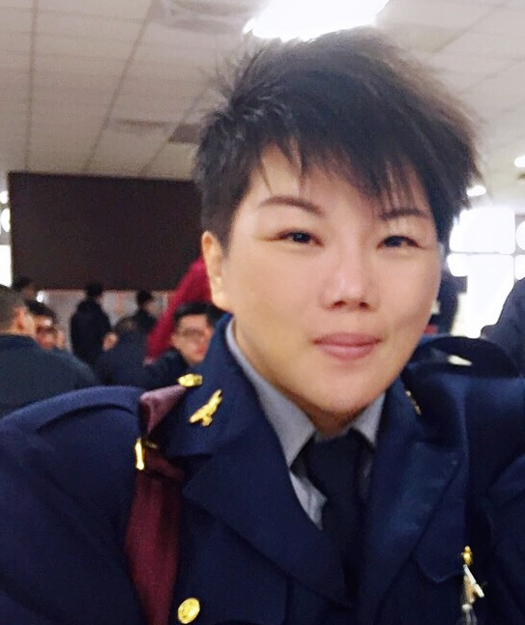
Presenter -- (Self-introduction)
My name is Li Wen Zeng and I come from Taiwan. Now mainly working as a juvenile crime investigator. I am currently serving in the juvenile police force of the Changhua County Police Department and have been working as a field juvenile delinquent investigator for many years.
Notes:
My name is Li Wen Zeng and I come from Taiwan.
Now mainly working as a juvenile crime investigator.
I am currently serving in the juvenile police force of the Changhua County Police Department
and have been working as a field juvenile delinquent investigator for many years.
I have been working as a police officer for many years and I love my job.
I am currently engaged in "academic research" as a life long study in addition to my work.

Slide 5
OUTLINE
Introduction
The current situation of drug use among juveniles in Taiwan
The dilemmas of the prevention and control mechanism of juvenile drug crimes in Taiwan
Measures to Prevent and Control Juvenile Drug Crimes in Taiwan--Conclusion
12/05/2021,Retrieved from https://byjus.com/biology/adolescence-and-drug-abuse/
Notes:
The main purpose of this paper is to examine
the current situation of the juvenile drug prevention and control mechanism in Taiwan
and the difficulties encountered in prevention and control,
and then to propose feasible countermeasures.
OUTLINE
1.Introduction
2.The current situation of drug use among juveniles in Taiwan
3.The dilemmas of the prevention and control mechanism of juvenile drug crimes in Taiwan
4.Measures to Prevent and Control Juvenile Drug Crimes in Taiwan--Conclusion

Slide 6
Introduction
Author‘s work characteristics: The author of this article has been handling various juvenile delinquency cases for a long time, and has been working mainly on juvenile drug investigation, and understands that drug crimes endanger national security and social order seriously.
Drug use has been on the rise around the world : According to the United Nations World Drug Report 2020, drug use has been increasing worldwide, both in total and as a proportion of the world's drug-using population. ˌIn 2018, an estimated ˈ 269 million people accounted for 5.3% of the global population aged 15-64.
Notes:
一、前言：根據2020年聯合國世界毒品問題報告中指出，世界各地的毒品施用量一直在上升，其中包括總人數和比例上佔世界吸毒人口的比例。
在2018年估計約有2.69億人在全球15-64歲人口中佔5.3%的比率。
The author of this paper works in the juvenile police force of Changhua County Police Department
and has been handling various juvenile delinquency cases for a long time,
among which juvenile drug investigation is the main content of his work.
NOW I LL TALK ABOUT INTRODUCTION
The author of this paper works in the juvenile police force of Changhua County Police Department
and has been handling various juvenile delinquency cases for a long time,
among which juvenile drug investigation is the main content of MY work.
NOW I LL TALK ABOUT INTRODUCTION
According to the United Nations World Drug Report 2020, drug use has been increasing worldwide, both in total and as a proportion of the world's drug-using population. ˌIn 2018, an estimated ˈ 269 million people accounted for 5.3% of the global population aged 15-64.
本文作者因任職於彰化縣警察局少年警察隊，長期辦理青少年各項違法案件，
其中又以青少年毒品查緝為主要工作內容，研究者深知毒品犯罪危害國家安全及社會秩序情節重大

Slide 7
一、Introduction-1
Drug seizures in Taiwan are on the rise： According to the Ministry of Justice's April 2009 drug case statistics, drug seizures have been on the rise over the last 10 years.
108 years of drug seizures are the highest in 10 years： The 9,476.5 kilograms seized in 2008 was the highest in the past 10 years, And among them, Class 3 drugs accounted for the largest number of items.In addition, Class 4 drugs, the next largest category.
Notes:
Continue Introduction-1
This shows the importance of this study to examine the issue of juvenile drug use behavior and its influencing factors
According to the Ministry of Justice's April 2009 drug case statistics, drug seizures have been on the rise over the last 10 years.
The 9,476.5 kilograms seized in 2008 was the highest in the past 10 years, And among them, Class 3 drugs accounted for the largest number of items.In addition, Class 4 drugs, the next largest category.
我國法務部109年04月份毒品案件統計分析，最近10年來，毒品查獲量呈現增加之驅勢，
從108年所查獲之9476.5公斤，創下10年來的最高紀錄，而其中又以第三級毒品占45.7%為最多的項目，
另外，第四級毒品占30.3%，次之。

Slide 8
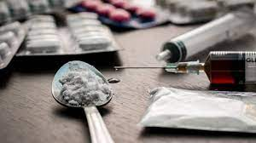
一、Introduction-2
The seriousness of drugs ： The above statistics show the seriousness of drug use, with Level 3 and 4 accounting for most of the seizures.
Youth as the main source of population ： The importance of this study in the prevention and treatment of juvenile delinquency in Taiwan is evident from the fact that youth are the main source of third- and fourth-degree drug use.
Retrieved from https://www.euractiv.com/section/politics/short_news/finland-hit-by-a-new-wave-of-drug-use/
Notes:
由上述數據可見施用毒品的嚴重性且施用情形氾濫，且其中又以第三、四級占查緝數量的大部分，
而在青少年又為施用第三、四級毒品的主要人口來源，由此可見，本研究探討台灣地區少年毒品犯罪防治議題之重要性。
The seriousness of drugs ： The above data shows the seriousness of drug use and the proliferation of drug use, with Level 3 and 4 accounting for most of the seizures.
Youth as the main source of population ： As youths are the main source of drug use in Class 3 and 4, it is important to study the prevention and treatment of juvenile drug abuse in Taiwan.

Slide 9
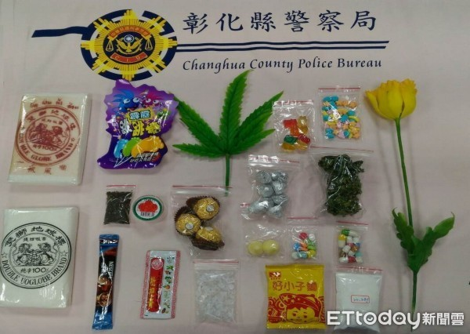
二、The current situation of drug use among juveniles in Taiwan
Characteristics of the work of the authors of this paper. The researcher has been working in the juvenile police force of Changhua County Police Department for a long time, handling various juvenile delinquency cases, among which youth drug investigation is the main task.
Tertiary and quaternary drugs are sources of drug use among adolescents.
Retrieved from https://health.ettoday.net/news/1503336?redirect=1
Notes:
研究者因任職於彰化縣警察局少年警察隊，長期辦理青少年各項違法案件，其中又以青少年毒品查緝為主要工作內容，研究者深知毒品犯罪危害國家安全及社會秩序情節重大。
根據我國教育部2020年3月「學生非法藥物使用行為調查研究摘要報告」中指出，在學生承認使用的非法藥物中，係以第三級毒品K他命最多，其次為新興毒品(例如毒品咖啡包) 。
The researcher has been working in the juvenile police force of Changhua County Police Department for a long time,
handling various juvenile delinquency cases, among which youth drug investigation is the main task.

Slide 10
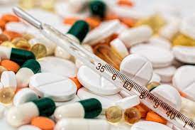
二、The current situation of drug use among juveniles in Taiwan-1
Students administering drugs ：According to the "Summary Report of the Survey on Students' Illegal Drug Use Behavior" by the Ministry of Education in March 2020, among the illegal drugs that students admitted to using, ketamine is the most popular drug of the third grade, followed by new drugs (e.g., coffee packets).
Emerging drugs of abuse! 12/05/2021, Retrieved from https://emottawablog.com/2015/10/emerging-drugs-of-abuse/
Notes:
next
the class 3 and class 4 drugs are sources of drug administration among youth.
According to the Department of Education's March 2020 Summary Report of the Student Survey of Illegal Drug Use, ketamine was the most popular drug among third graders among the illicit iˈlisit drugs students admitted to using, followed by newer drugs (e.g., coffee packets).
根據我國教育部2020年3月「學生非法藥物使用行為調查研究摘要報告」中指出，在學生承認使用的非法藥物中，係以第三級毒品K他命最多，其次為新興毒品(例如毒品咖啡包) 。

Slide 11
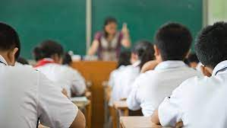
二、The current situation of drug use among juveniles in Taiwan-2
Official Statistics：In addition, according to the Ministry of Health and Welfare (MOHW) Annual Report on Student Drug Abuse Statistics for the month of October 108, there were 608 cases of student drug abuse in Taiwan in the year 108, according to the Food and Drug Administration, MOHW (2020).
Student drug use! 12/05/2021, Retrieved from https://www.parenting.com.tw/article/5076030
Notes:
在104年至107年資料統計中，學生自承曾經使用非法藥物比率為0.17%-1.03%之間；另外，依據衛生福利部108月學生藥物濫用檢驗統計年報資料顯示，108年全年統計台灣地區學生藥物濫用共計608件， 衛生福利部食品藥物管理署(2020)。臺灣地區學生藥物濫用統計表如下所示。
In addition, according to the Ministry of Health and Welfare (MOHW) Annual Report on Student Drug Abuse Statistics for the month of October 108, there were 608 cases of student drug abuse in Taiwan in the year 108, according to the Food and Drug Administration, MOHW (2020).

Slide 12
Drug Abuse Statistics for Students in Taiwan (100-109年)
Notes:
臺灣臺灣地區學生藥物濫用統計表
this is Drug Abuse Statistics for Students in Taiwan satistics time (100-109年)
The school system includes elementary school. Junior high school. High school and university students

Slide 13
三、The dilemmas of the prevention and control mechanism of juvenile drug crimes in Taiwan
The main purpose :The main purpose of this paper is to investigate the current situation of the prevention and control mechanism of juvenile drug offenses in Taiwan and the difficulties encountered in prevention and control, and then to propose feasible countermeasures.
Research Methodology :In the research design and methodology section of this paper, the research method is literature
Notes:
在本文的研究目的部分，主文主要係要探討台灣地區少年毒品犯罪防治機制之現況及防治面所遇到之困境，
之後，並提出可行之回應對策。在本文的研究設計與方法部分，研究方法為文獻探討法。
The purpose of this paper is to examine the current situation of the prevention and control mechanism of juvenile drug offenses in Taiwan and the difficulties encountered in prevention and control, and to propose feasible countermeasures.
In the research design and methodology section of this paper, the research method is the literature research method.

Slide 14
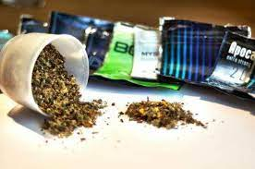
三、The dilemmas of the prevention and control mechanism of juvenile drug crimes in Taiwan-1
The preliminary findings of this paper are as follows:
Emerging drugs emerge in endlessly： New drugs are emerging all the time, and law enforcement officers have a difficult time determining whether they meet the definition of a drug under the Drug Endangerment Prevention Ordinance.
The role and function of the tutoring agency are still unclear：The role and function of the juvenile counseling committee is still not clear.
Emerging drugs of abuse! 12/05/2021, Retrieved from https://medicalxpress.com/news/2013-10-emerging-drugs.html
Notes:
next
The findings of this paper are as follows: The following are some of the dilemmas of the juvenile drug prevention and control mechanism in Taiwan:
（1）Emerging drugs are emerging all the time,
and it is difficult for law enforcement officers and school staff to determine whether the emerging drugs meet the definition ˌdefəˈniSH(ə)n of drugs in the Drug Hazard Prevention and Control Act.
(2) The role and function ˌ of the juvenile counseling committee is still not clear.
本文初步的發現如下：在台灣地區少年毒品犯罪防治機制之困境部分，如下所述：
（一）新興毒品層出不窮，執法人員、學校的校職員針對新興毒品之判斷上，在決定其是否符合毒品危害防制條例的毒品定義時，有其困難度。
（二）少年輔導委員會之角色與功能仍未明確化。
（三）有關持有第三級毒品純質淨重五公克以上者，目前，得併科新臺幣二十萬元以下罰金，此種處罰額度，恐未具有威嚇力道。
（四）持有第四級毒品純質淨重五公克以上者，目前，得併科新臺幣十萬元以下罰金，此種處罰額度，恐未具有威嚇力道。

Slide 15
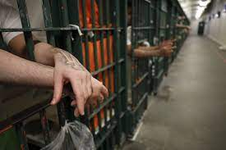
三、The dilemma of the prevention and control mechanism of juvenile drug crimes in Taiwan-2
(3) Penalties for possession of Class 3 drugs：The current penalty for possession of Class III drugs weighing 5 grams or more is a fine, which may not have a deterrent effect.
(4) Penalties for possession of Class 4 drugs： Possession of Class IV drugs weighing 5 grams or more net is currently subject to a fine only.
Retrieved from https://www.latimes.com/california/story/2020-03-30/coronavirus-inmates-hygiene-supply-shortage-la-jails
Notes:
(3) The current penalty for possession of Class 3 drugs of a net weight of 5 grams or more is a fine of up to NT$200,000.(Two hundred thousand new Taiwan dollars.)
(4) A person who possesses a Class 4 drug with a net weight of 5 grams or more is currently subject to a fine of up to NT$100,000
.(one hundred thousand new Taiwan dollars.）
本文初步的發現如下：在台灣地區少年毒品犯罪防治機制之困境部分，如下所述：
（三）有關持有第三級毒品純質淨重五公克以上者，目前，得併科新臺幣二十萬元以下罰金，此種處罰額度，恐未具有威嚇力道。
（四）持有第四級毒品純質淨重五公克以上者，目前，得併科新臺幣十萬元以下罰金，此種處罰額度，恐未具有威嚇力道。

Slide 16
四、Conclusion
Strengthened judgment
Define the role of counselors
Increased penalties class 3 drugs
Increased penalties class 4 drugs
Notes:
(1) Strengthen and improve the ability of law enforcement officers and school staff to judge drugs
(2) Clarify the role, and mission, goals, and functions of the Youth Counseling Committee.
（3) Increase penalties for possession of Class III drugs with a net weight of 5 grams or more to make them more deterrent;
(4) Increase penalties for possession of Class IV drugs with a net weight of 5 grams or more to make them more deterrent.

Slide 17
四、Conclusion-1
Conclusions and Recommendations:
(1) Strengthened judgment：Strengthen and enhance the ability of law enforcement officers and school staff to judge whether the nature of emerging drugs meets the definition of drugs in the Drug Hazard Prevention and Control Act.
(2) Define the role of counselors：To clarify and refine the roles, tasks, and functions of the juvenile counseling committee.
Notes:
This paper proposes the following feasible measures for the prevention and control mechanism of juvenile drug offenses in Taiwan,
in the hope of effectively reducing juvenile drug offenses in Taiwan:
(1) Strengthened judgment：Strengthen and enhance the ability of law enforcement officers and school staff to judge whether the nature of emerging drugs meets the definition of drugs in the Drug Hazard Prevention and Control Act.
（2）To clarify and refine the roles, tasks, and functions of the juvenile counseling committee.
在台灣地區少年毒品犯罪防治機制之對策部分，本文提出以下之可行作法，俾供各界卓參之用，期望能有效地降低台灣地區少年毒品犯罪：（一）強化、提升執法人員、學校的校職員針對新興毒品之本質，是否符合毒品危害防制條例的毒品定義之判斷能力。（二）明確化、精準化少年輔導委員會之角色、任務與功能。

Slide 18
四、Conclusion-2
(3) Increased penalties for class 3 drugs：To increase the penalty for possession of Class III drugs so that it has a deterrent effect.
(4) Increased penalties class 4 drugs：To increase the penalty for possession of Class IV drugs to a deterrent effect.
Notes:
Conclusion-2
To increase the penalty for possession of Class 3 drugs with a net weight of 5 grams or more, so that it has a deterrent effect.
To increase the penalty for possession of Class 4 drugs with a net weight of 5 grams or more to make it a deterrent.
The fact that most of the users of Class 3 and Class 4 drugs
are teenagers shows that Class 3 and Class 4 drugs cause serious physical ˈfizik(ə)l and psychological ˌsīkəˈläjək (ə) l to teenagers,
And the fact that criminal laws are not criminalized and only directing penalties are imposed makes it difficult for the government to control -Repeat offense

Slide 19
四、Conclusion-3
Drug abuse is a major threat to national security and social order, and drug abusers cannot easily quit their addiction, resulting in long-term physical and psychological damage and the destruction of countless families.
Notes:
Conclusion-4
The author of this paper has served in the juvenile police force of Changhua County Police Department and has been handling youth drug investigation for a long time.
The author understands that drug crimes endanger national security and social order, and drug abusers cannot easily quit their drug addiction, which leads to long-term physical and psychological damage, and also causes countless family breakdowns.
Therefore, the study of the factors influencing drug abuse among Teenagers is aimed at eliminating drug abuse among Teenagers in the hope of helping our country and society.

Slide 20
TOU
THANK YOU!
Insert the Subtitle of Your Presentation

